Slide 1
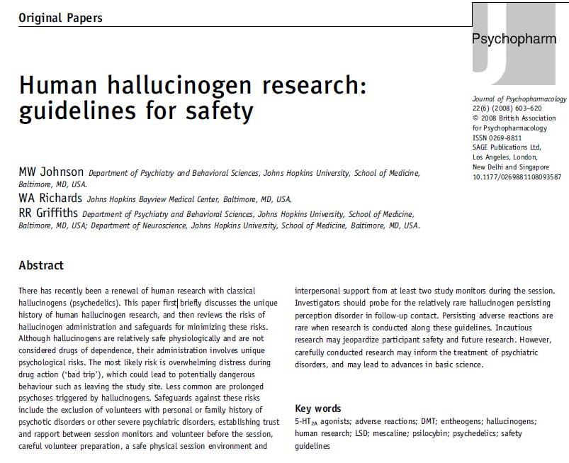
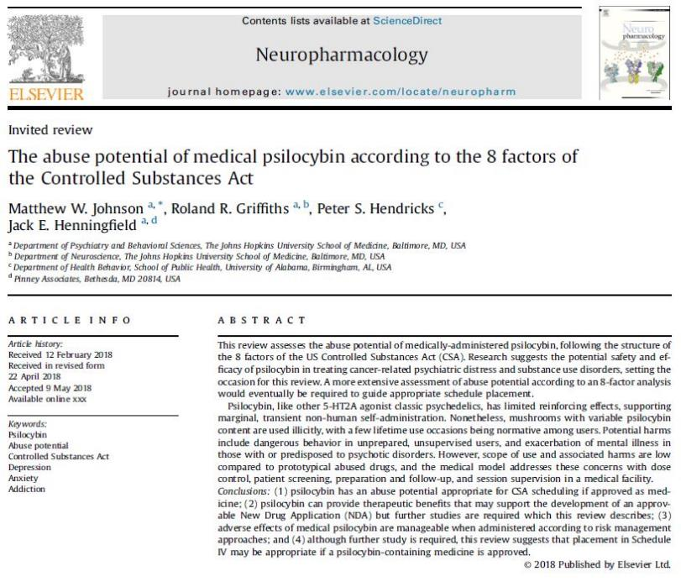
Addressing the Dark Side: Risks and Safeguards

Slide 2
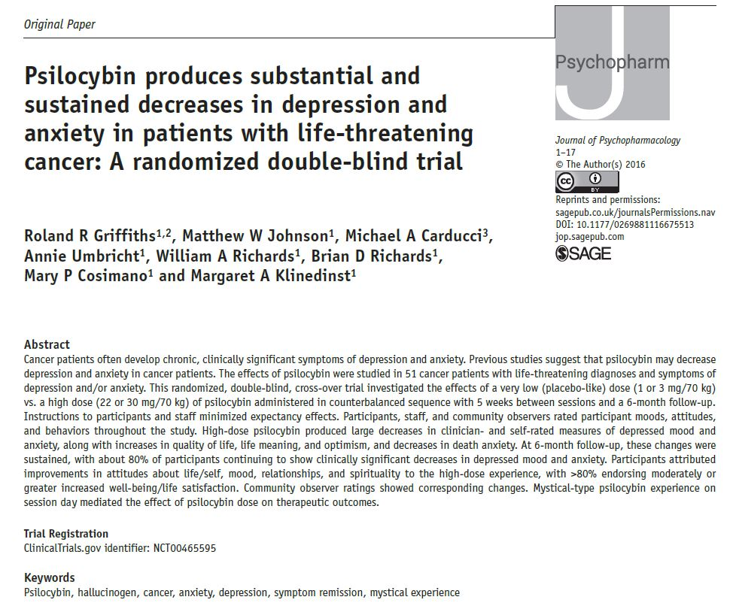
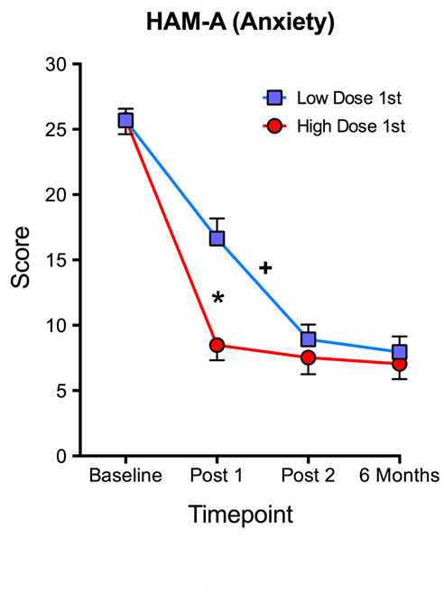
Unprecedented Treatment of Depression and Anxiety in Cancer Patients

Slide 3
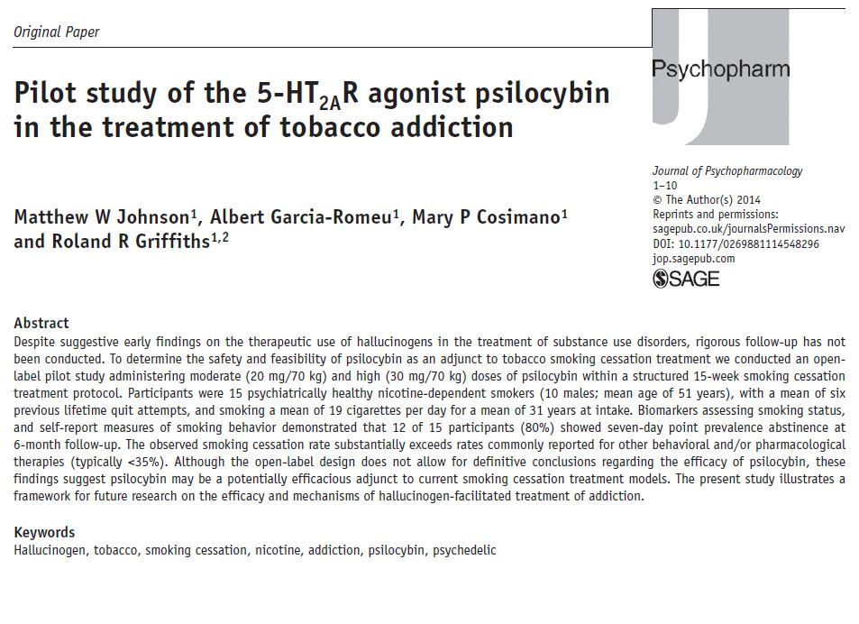
Smoking Cessation Rates Substantially Higher than Existing Treatments

